Slide 1
Data Wrangling with Pandas II
20/07/2024

Slide 2
Reordering, Reindexing, & Sorting Data
We will often find the need to sort our data by the values of one or many columns. Say we wanted to find the days that reached the highest temperatures in New York City during October 2018; we could sort our values by the temp_C (or temp_F) column in descending order and use head() to select the number of days we wanted to see.
To accomplish this, we can use the sort_values() method. Let's look at the top 10 days:

Slide 3
Reordering, Reindexing, & Sorting Data
The result is like:

Slide 4
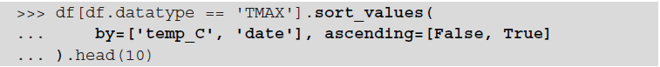
Reordering, Reindexing, & Sorting Data
The sort_values() method can be used with a list of column names to break ties. The order in which the columns are provided will determine the sort order, with each
subsequent column being used to break ties.

Slide 5
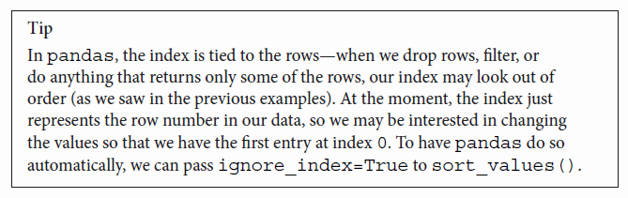
Reordering, Reindexing, & Sorting Data

Slide 6
Reordering, Reindexing, & Sorting Data
Pandas also provides an additional way to look at a subset of the sorted values; we can use nlargest() to grab the n rows with the largest values according to specific criteria and nsmallest() to grab the n smallest rows, without the need to sort the data beforehand.

Slide 7
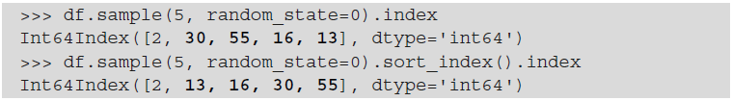
Reordering, Reindexing, & Sorting Data
We aren't limited to sorting values; if we wish, we can even order the columns alphabetically and sort the rows by their index values.
For these tasks, we can use the sort_index() method.
By default, sort_index() will target the rows, When we want to target columns, we must pass in axis=1.

Slide 8
Reordering, Reindexing, & Sorting Data
Let's use this knowledge to sort the columns of our dataframe alphabetically:
Having our columns in alphabetical order can come in handy when using loc[] because we can specify a range of columns with similar names; for example, we could now use df.loc[:,'station':'temp_F_whole'] to easily grab all of our temperature columns, along with the station information:

Slide 9
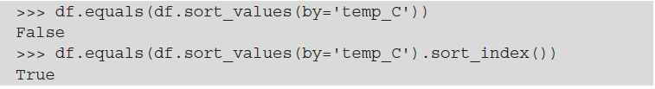
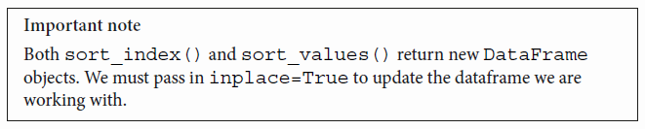
Reordering, Reindexing, & Sorting Data
The sort_index() method can also help us get an accurate answer when we’re \ testing two dataframes for equality.

Slide 10
Reordering, Reindexing, & Sorting Data
Sometimes, we don't care too much about the numeric index, but we would like to use one (or more) of the other columns as the index instead. In this case, we can use the set_index() method. Let's set the date column as our index:

Slide 11
Reordering, Reindexing, & Sorting Data
Setting the index to a datetime lets us take advantage of datetime slicing and indexing:
Both Inclusive

Slide 12
Reordering, Reindexing, & Sorting Data
We can use the reset_index() method to restore the date column:

Slide 13
Reshaping Data
Sometimes, we need to be able to restructure data into both wide and long formats, depending on the analysis we want to perform.
For many analyses, we will want wide format data so that we can look at the summary statistics easily and share our results in that format.
However, this isn't always as black and white as going from long format to wide format or vice versa. Consider the following data:
Long
Wide

Slide 14
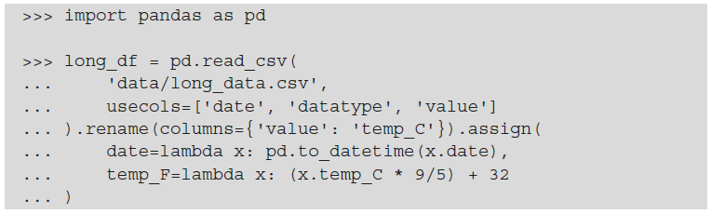
Reshaping Data
We will begin by importing pandas and reading in the long_data.csv file, adding the temperature in Fahrenheit column (temp_F), and performing some of the data cleaning we just learned about:
We will discuss transposing, pivoting, and melting our data.
Note that after reshaping the data, we will often revisit the data cleaning tasks as things may have changed, or we may need to change things we couldn't access easily before.

Slide 15
Transposing DataFrames
While we will be pretty much only working with wide or long formats, pandas provides ways to restructure our data as we see fit, including taking the transpose (flipping the rows with the columns):
Notice that the index is now in the columns, and that the column names are in the index:
It may not be immediately apparent how useful this can be, but we will see this a quite few times throughout this course.

Slide 16
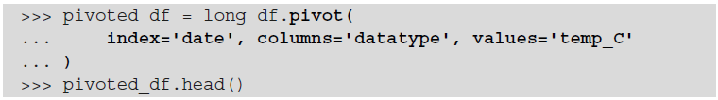
Pivoting DataFrames
We pivot our data to go from long format to wide format. The pivot() method performs this restructuring of our DataFrame object.
To pivot, we need to tell pandas which column currently holds the values (with the values argument) and the column that contains what will become the column names in wide format (the columns argument).
Optionally, we can provide a new index (the index argument).

Slide 17
Pivoting DataFrames
As we discussed, with the data in wide format, we can easily get meaningful summary statistics with the describe() method:
We can see that we have 31 observations for all three temperature measurements and that this month has a wide range of temperatures (highest daily maximum of 26.7°C and lowest daily minimum of -1.1°C):

Slide 18
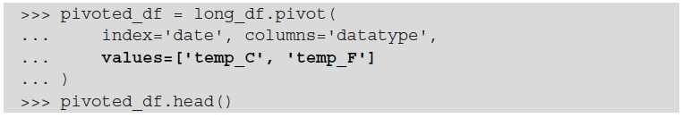
Pivoting DataFrames
We lost the temperature in Fahrenheit, though. If we want to keep it, we can provide multiple columns to values:
However, we now get an extra level above the column names. This is called a hierarchical index:

Slide 19
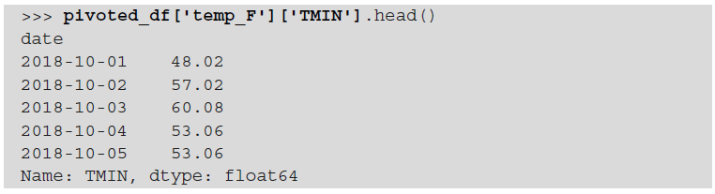
Pivoting DataFrames
With this hierarchical index, if we want to select TMIN in Fahrenheit, we will first need to select temp_F and then TMIN:

Slide 20
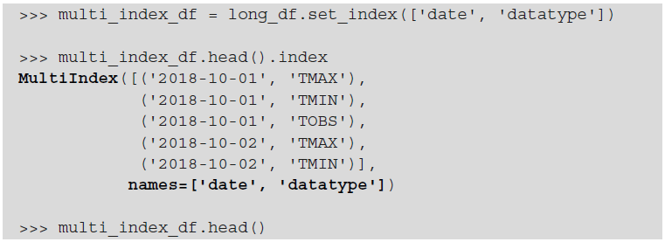
Pivoting DataFrames
We can create an index from any number of columns with set_index(). This gives us an index of type MultiIndex, where the outermost level corresponds to the first element in the list provided to set_index():

Slide 21
Pivoting DataFrames
Notice that we now have two levels in the index—date is the outermost level and datatype is the innermost:

Slide 22
Pivoting DataFrames
The pivot() method expects the data to only have one column to set as the index; if we have a multi-level index, we should use the unstack() method instead.
Order matters here because, by default, unstack() will move the innermost level of the index to the columns; To unstack a different level, simply pass in the index of the level to unstack, where 0 is the leftmost and -1 is the rightmost, or the name of the level.

Slide 23
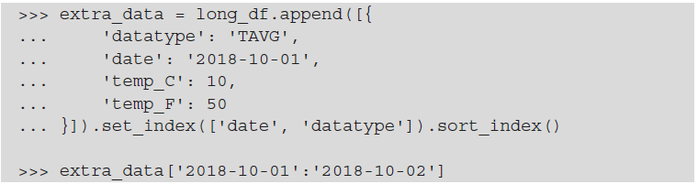
Pivoting DataFrames
The unstack() method has the added benefit of allowing us to specify how to fill in missing values that come into existence upon reshaping the data.

Slide 24
Pivoting DataFrames
Using unstack(), as we did previously, will result in NaN values for most of the TAVG data:

Slide 25
Pivoting DataFrames
To address this, we can pass in an appropriate fill_value. However, we are restricted to passing in a value for this, not a strategy
To summarize, unstack() should be our method of choice when we have a multi level index and would like to move one or more of the levels to the columns; however, if we are simply using a single index, the pivot() method's syntax is likely to be easier to specify correctly since it's more apparent which data will end up where.

Slide 26
Melting DataFrames
To go from wide format to long format, we need to melt the data. Melting undoes a pivot. For this example, we will read in the data from the wide_data.csv file:
Our wide data contains a column for the date and a column for each temperature measurement we have been working with:

Slide 27
Melting DataFrames
We can use the melt() method for flexible reshaping—allowing us to turn this into long format, similar to what we got from the API. Melting requires that we specify the following:
• Which column(s) uniquely identify a row in the wide format data with the id_vars argument
• Which column(s) contain(s) the variable(s) with the value_vars argument
Optionally, we can also specify how to name the column containing the variable names in the long format data (var_name) and the name for the column containing their values (value_name). By default, these will be variable and value, respectively.

Slide 28
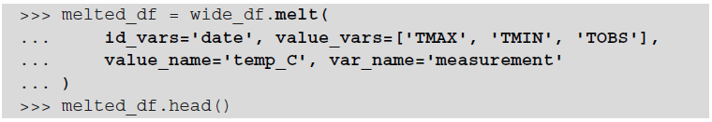
Melting DataFrames
Now, let's use the melt() method to turn the wide format data into long format:

Slide 29
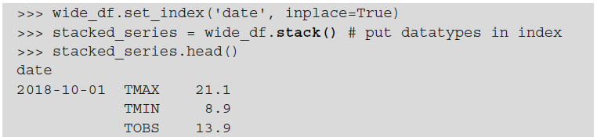
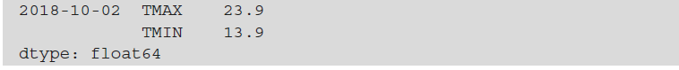
Melting DataFrames
Just as we had an alternative way of pivoting data with the unstack() method, we also have another way of melting data with the stack() method.
This method will pivot the columns into the innermost level of the index (resulting in an index of type MultiIndex), so we need to double-check our index before calling it.

Slide 30
Melting DataFrames
Notice that the result came back as a Series object, so we will need to create the DataFrame object once more.
Now, we have a dataframe with a multi-level index, containing date and datatype, with values as the only column. Notice, however, that only the date portion of our index has a name:

Slide 31
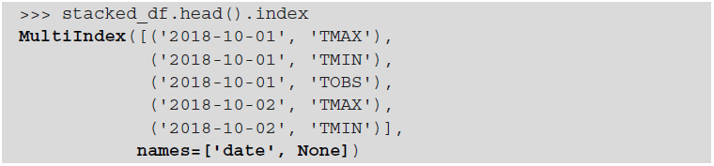
Melting DataFrames
Initially, we used set_index() to set the index to the date column because we didn’t want to melt that; this formed the first level of the multi-level index.
Then, the stack() method moved the TMAX, TMIN, and TOBS columns into the second level of the index. However, this level was never named, so it shows up as None, but we know that the level should be called datatype:

Slide 32
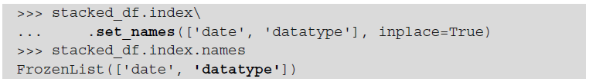
Melting DataFrames
We can use the set_names() method to address this:

Slide 33
Handling Duplicate, Missing, or Invalid Data
This is separated from the rest of the data cleaning discussion because it is an example where we will do some initial data cleaning, then reshape our data, and finally look to handle these potential issues.
The dirty_data.csv file contains wide format data from the weather API that has been altered to introduce many common data issues:
It contains the following fields:
• PRCP: Precipitation in millimeters
• SNOW: Snowfall in millimeters
• SNWD: Snow depth in millimeters
• TMAX: Maximum daily temperature in Celsius
• TMIN: Minimum daily temperature in Celsius
• TOBS: Temperature at the time of observation in Celsius
• WESF: Water equivalent of snow in millimeters

Slide 34
Finding the Problematic Data
Examining the results of calling head() and tail() on the data is always a good first step:

Slide 35
Finding the Problematic Data
Using describe(), we can see if we have any missing data and look at the 5-number summary to spot potential issues:
Unreliable.
Useless

Slide 36
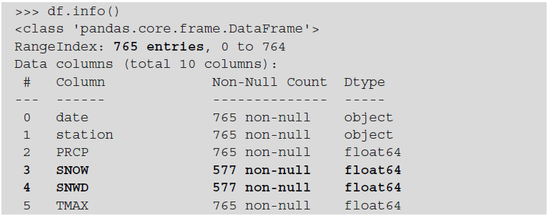
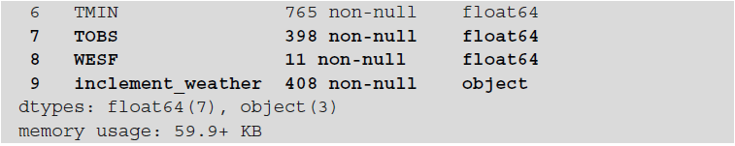
Finding the Problematic Data
We can use the info() method to see if we have any missing values and check that our columns have the expected data types.
Notice that the ? value that we saw for the station column when we used head() doesn't show up here—it's important to inspect our data from many different angles.
Null Values
Not Boolean

Slide 37
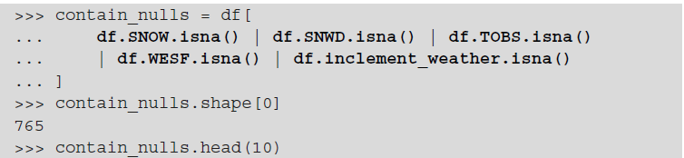
Finding the Problematic Data
Now, let's track down those null values. Both Series and DataFrame objects provide two methods to do so: isnull() and isna().
If we look at the shape attribute of contain_nulls dataframe, we will see that every single row contains some null data.

Slide 38
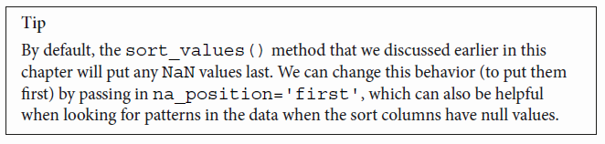
Finding the Problematic Data

Slide 39
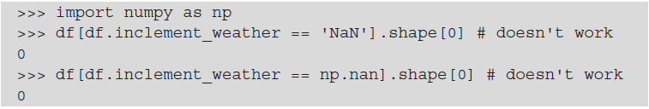
Finding the Problematic Data
Note that we can't check whether the value of the column is equal to NaN because NaN is not equal to anything:
We must use the aforementioned options (isna()/isnull()):

Slide 40
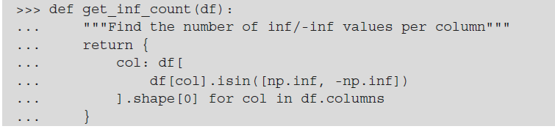
Finding the Problematic Data
Note that inf and -inf are actually np.inf and -np.inf. Therefore, we can find the number of rows with inf or -inf values by doing the following:
This only tells us about a single column, though, so we could write a function that will use a dictionary comprehension to return the number of infinite values per column in our dataframe:

Slide 41
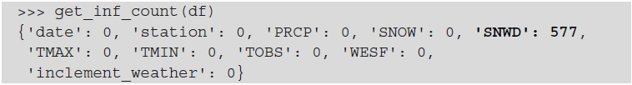
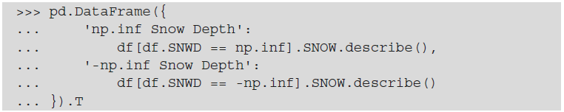
Finding the Problematic Data
Using our function, we find that the SNWD column is the only column with infinite values, but the majority of the values in the column are infinite:
Before we can decide on how to handle the infinite values, we should look at the summary statistics for snowfall (SNOW), which forms a big part of determining the snow depth (SNWD).

Slide 42
Finding the Problematic Data
The snow depth was recorded as negative infinity when there was no snowfall; however, we can't be sure this isn't just a coincidence going forward.
If we are just going to be working with this fixed date range, we can treat that as having a depth of 0 or NaN because it didn't snow.
Unfortunately, we can't really make any assumptions with the positive infinity entries. So, we can't decide what they should be, it's probably best to leave them alone or not look at this column.

Slide 43
Finding the Problematic Data
We are working with a year of data, but somehow, we have 765 rows, so we should check why.
The only columns we have yet to inspect are the date and station columns. We can use the describe() method to see the summary statistics for them:

Slide 44
Finding the Problematic Data
In 765 rows of data, the date column only has 324 unique values, with some dates being present as many as eight times (freq).
There are only two unique values for the station column, with the most frequent being GHCND:USC00280907.
Since we saw some station IDs with the value of ? when we used head() earlier, we know that is the other value; however, we can use unique() to see all the unique values if we hadn’t.
We also know that ? occurs 367 times (765 - 398), without the need to use value_counts()

Slide 45
Finding the Problematic Data
Upon seeing that we had 765 rows of data and two distinct values for the station ID, we might have assumed that each day had two entries—one per station. However, this would only account for 730 rows, and we also now know that we are missing some dates.
Let's see whether we can find any duplicate data that could account for this. We can use the result of the duplicated() method as a Boolean mask to find the duplicate rows:
Counts all

Slide 46
Finding the Problematic Data
There is also a subset argument (first positional argument), which allows us to focus just on the duplicates of certain columns.
Some rows are repeated at least three times. Remember that the default behavior of duplicated() is to not show the first occurrence

Slide 47
Mitigating the Issues
Our data is in an unsatisfactory state, and improving it isn't always straightforward. The simplest approach might be to remove duplicate rows, but we must consider the impact on our analysis. If our data was part of a larger dataset with additional columns, the remaining data might still be duplicated for other reasons. We need to consult the data source and available documentation to understand this
Since both stations are for New York City, we can drop the station column.
If we remove duplicate rows based on the date column and keep data from the non-? station, we will lose all WESF data because only the ? station reports WESF measurements.

Slide 48
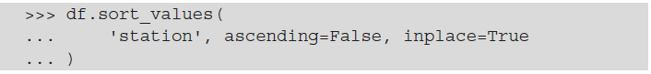
Mitigating the Issues
One satisfactory solution in this case may be to carry out the following actions:
1. Perform type conversion on the date column:
2. Save the WESF column as a series:
3. Sort the dataframe by the station column in descending order to put the station with no ID (?) last:

Slide 49
Mitigating the Issues
4. Remove rows that are duplicated based on the date, keeping the first occurrences, which will be ones where the station column has an ID (if that station has measurements).
5. Drop the station column and set the index to the date column (so that it matches the WESF data):

Slide 50
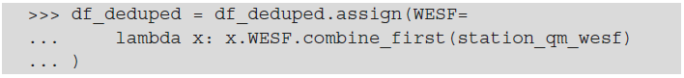
Mitigating the Issues
6. Update the WESF column using the combine_first() method to coalesce (just as in SQL for those coming from a SQL background) the values to the first non-null entry;
This means that if we had data from both stations, we would first take the value provided by the station with an ID, and if (and only if) that station was null would we take the value from the station without an ID (?).
Since both df_deduped and station_qm_wesf are using the date as the index, the values are properly matched to the appropriate date.

Slide 51
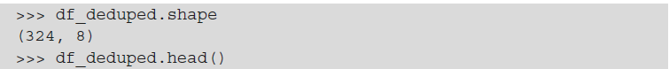
Mitigating the Issues
Let's take a look at the result using the aforementioned implementation:

Slide 52
Mitigating the Issues
Now, let's deal with the null data. We can choose to drop it, replace it with some arbitrary value, or impute it using surrounding data.
To drop all the rows with any null data (this doesn't have to be true for all the columns of the row, so be careful), we use the dropna() method; in our case, this leaves us with just 4 rows:
We can change the default behavior to only drop a row if all the columns are null with the how argument, except this doesn't get rid of anything:

Slide 53
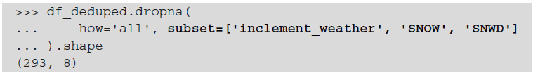
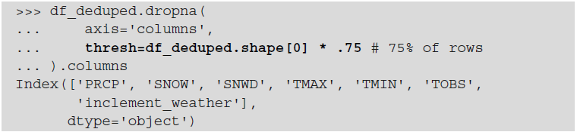
Mitigating the Issues
We can also use a subset of columns to determine what to drop. Say we wanted to look at snow data:
Note that this operation can also be performed along the columns, and that we can provide a threshold for the number of null values that must be observed to drop the data with the thresh argument. For example, if we say that at least 75% of the rows must be null to drop the column, we will drop the WESF column:

Slide 54
Mitigating the Issues
Since we have a lot of null values, we will likely be more interested in keeping these values, and perhaps finding a better way to represent them.
To fill in null values with other data, we use the fillna() method, which gives us the option of specifying a value or a strategy for how to perform the filling.
The WESF column contains mostly null values, it is a measurement in milliliters that takes on the value of NaN when there is no water equivalent of snowfall, we can fill in the nulls with zeros.

Slide 55
Mitigating the Issues
The WESF column no longer contains NaN values:

Slide 56
Mitigating the Issues
At this point, we have done everything we can without distorting the data. We know that we are missing dates, but if we reindex, we don't know how to fill in the resulting NaN values.
With the weather data, we can't assume that because it snowed one day that it will snow the next, or that the temperature will be the same.
For this reason, note that the following examples are just for illustrative purposes only—just because we can do something doesn't mean we should. The right solution will most likely depend on the domain and the problem we are looking to solve.

Slide 57
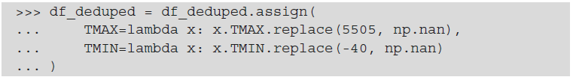
Mitigating the Issues
We know that when TMAX is the temperature of the Sun, it must be because there was no measured value, so let's replace it with NaN. We will also do so for TMIN, which currently uses -40°C for its placeholder.
We will also make an assumption that the temperature won't change drastically from day to day. Note that this is actually a big assumption, but it will allow us to understand how the fillna() method works when we provide a strategy through the method parameter: 'ffill' to forward-fill or 'bfill' to back-fill.

Slide 58
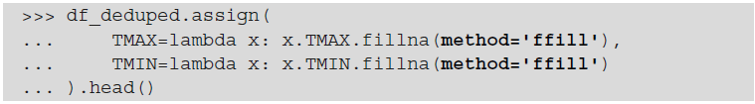
Mitigating the Issues
To illustrate how this works, let's use forward-filling:

Slide 59
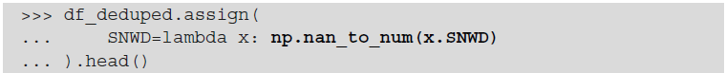
Mitigating the Issues
If we want to handle the nulls and infinite values in the SNWD column, we can use the np.nan_to_num() function; it turns NaN into 0 and inf/-inf into very large positive/negative finite numbers, making it possible for machine learning models to learn from this data:
This approach isn't suitable for our use case. For -np.inf, we can set SNWD to 0 since there was no snowfall on those days.
However, np.inf and large positive numbers make the data harder to interpret

Slide 60
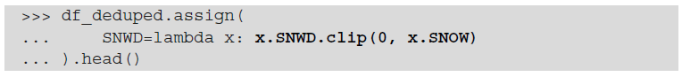
Mitigating the Issues
Depending on the data we are working with, we may choose to use the clip() method as an alternative to the np.nan_to_num() function. The clip() method makes it possible to cap values at a specific minimum and/or maximum threshold.

Slide 61
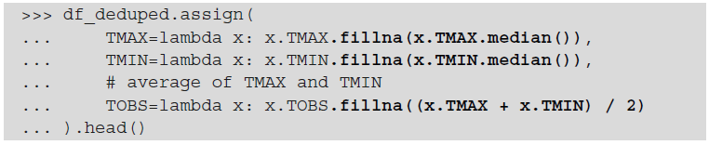
Mitigating the Issues
Our last strategy is imputation. When we replace a missing value with a new value derived from the data, using summary statistics or data from other observations.
We can combine imputation with the fillna() method. As an example, let's fill in the NaN values for TMAX and TMIN with their medians and TOBS with the average of TMIN and TMAX (after imputing them):

Slide 62
Mitigating the Issues
Notice from the changes to the data for January 1st and 4th that the median maximum and minimum temperatures were 14.4°C and 5.6°C, respectively.
This means that when we impute TOBS and also don't have TMAX and TMIN in the data, we get 10°C:

Slide 63
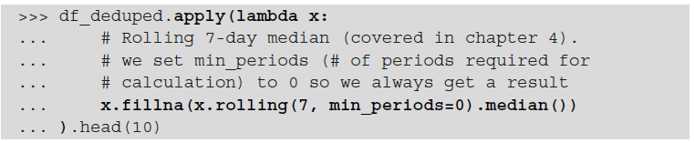
Mitigating the Issues
If we want to run the same calculation on all the columns, we should use the apply() method instead of assign(), since it saves us the redundancy of having to write the same calculation for each of the columns.

Slide 64
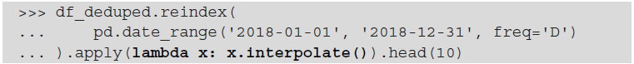
Mitigating the Issues
Another way of imputing missing data is to have pandas calculate what the values should be with the interpolate() method.
By default, it will perform linear interpolation, making the assumption that all the rows are evenly spaced. Our data is daily data, although some days are missing, so it is just a matter of reindexing first. Let's combine this with the apply() method to interpolate all of our columns at once:

Slide 65
Mitigating the Issues
Check out January 9th, which we didn't have previously—the values for TMAX, TMIN, and TOBS are the average of the values for the day prior (January 8th) and the day after (January 10th):
Different strategies for interpolation can be specified via the method argument; check out the interpolate() method documentation to view the available options.

Slide 66
Q&A
Questions and answers

Slide 67
Thanks!

